Slide 1






For each mechanism shown, find the degrees-of-freedom when curved contacts have (a) pure rolling (b) rolling and sliding
+
drawing 0003
J

Slide 2



+
drawing 0005

Slide 3


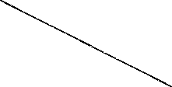
+
drawing 0008

Slide 4
drw 0011
+

Slide 5







+
+
drw 0026
2

Slide 6







+
+
drw0026a

Slide 7
drw 0062

Slide 8
J
J
?
+
+
?
drw 0002

